Slide 1
Graphs

Slide 2
A graph is a data structure that consists of a set of nodes (vertices) and a set of edges that connect pairs of nodes.
Nodes (Vertices): Nodes are the fundamental building blocks of a graph.
Each node represents an entity, and it may contain additional information.
For example, in a social network graph, nodes might represent users, while in a transportation network graph, nodes might represent locations or cities.

Slide 3
Edges: Edges are the connections between nodes.
They represent relationships or interactions between the entities represented by the nodes.
An edge may be directed or undirected.
In a directed graph, edges have a specific direction indicating a one-way relationship, while in an undirected graph, edges have no inherent direction.

Slide 4
Weighted Graphs:
In addition to edges connecting nodes, a weighted graph assigns a weight or cost to each edge.
These weights represent some measure of distance, cost, or importance associated with traversing the edge.
Weighted graphs are used to model scenarios where edges have varying degrees of significance.

Slide 5
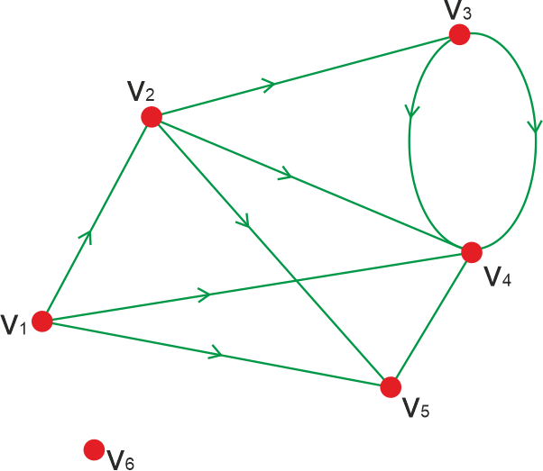
Degree:
The degree of a node is the number of edges incident to that node. In a directed graph, nodes have both an in-degree (number of incoming edges) and an out-degree (number of outgoing edges)

Slide 6
Path: A path in a graph is a sequence of nodes connected by edges.
It represents a route through the graph from one node to another.
The length of a path is the number of edges it contains.
Cycle: A cycle in a graph is a path that starts and ends at the same node, traversing a sequence of distinct nodes and edges along the way.

Slide 7
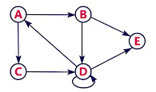
Representation of Graphs
Adjacency Matrix:
This is a 2D array where each cell A[i][j] represents the connection between vertex i and vertex j.
For an undirected graph, it is symmetric; for a directed graph, it may not be.
The value in each cell can represent the weight of the edge or simply whether there's an edge (e.g., 1 for presence, 0 for absence).

Slide 8
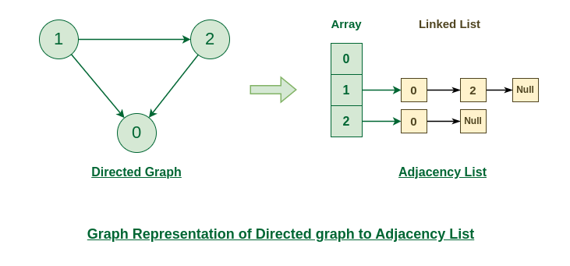
Adjacency List:
This is a collection of lists or arrays where each list/array represents a vertex and contains the vertices that are adjacent to it.
This representation is more memory-efficient for sparse graphs.

